Slide 1
R Shiny App: Student Mental Health
Robert Garcia
Fall 2022

Slide 2

Research Question
How does student mental health vary across demographics?

Slide 3
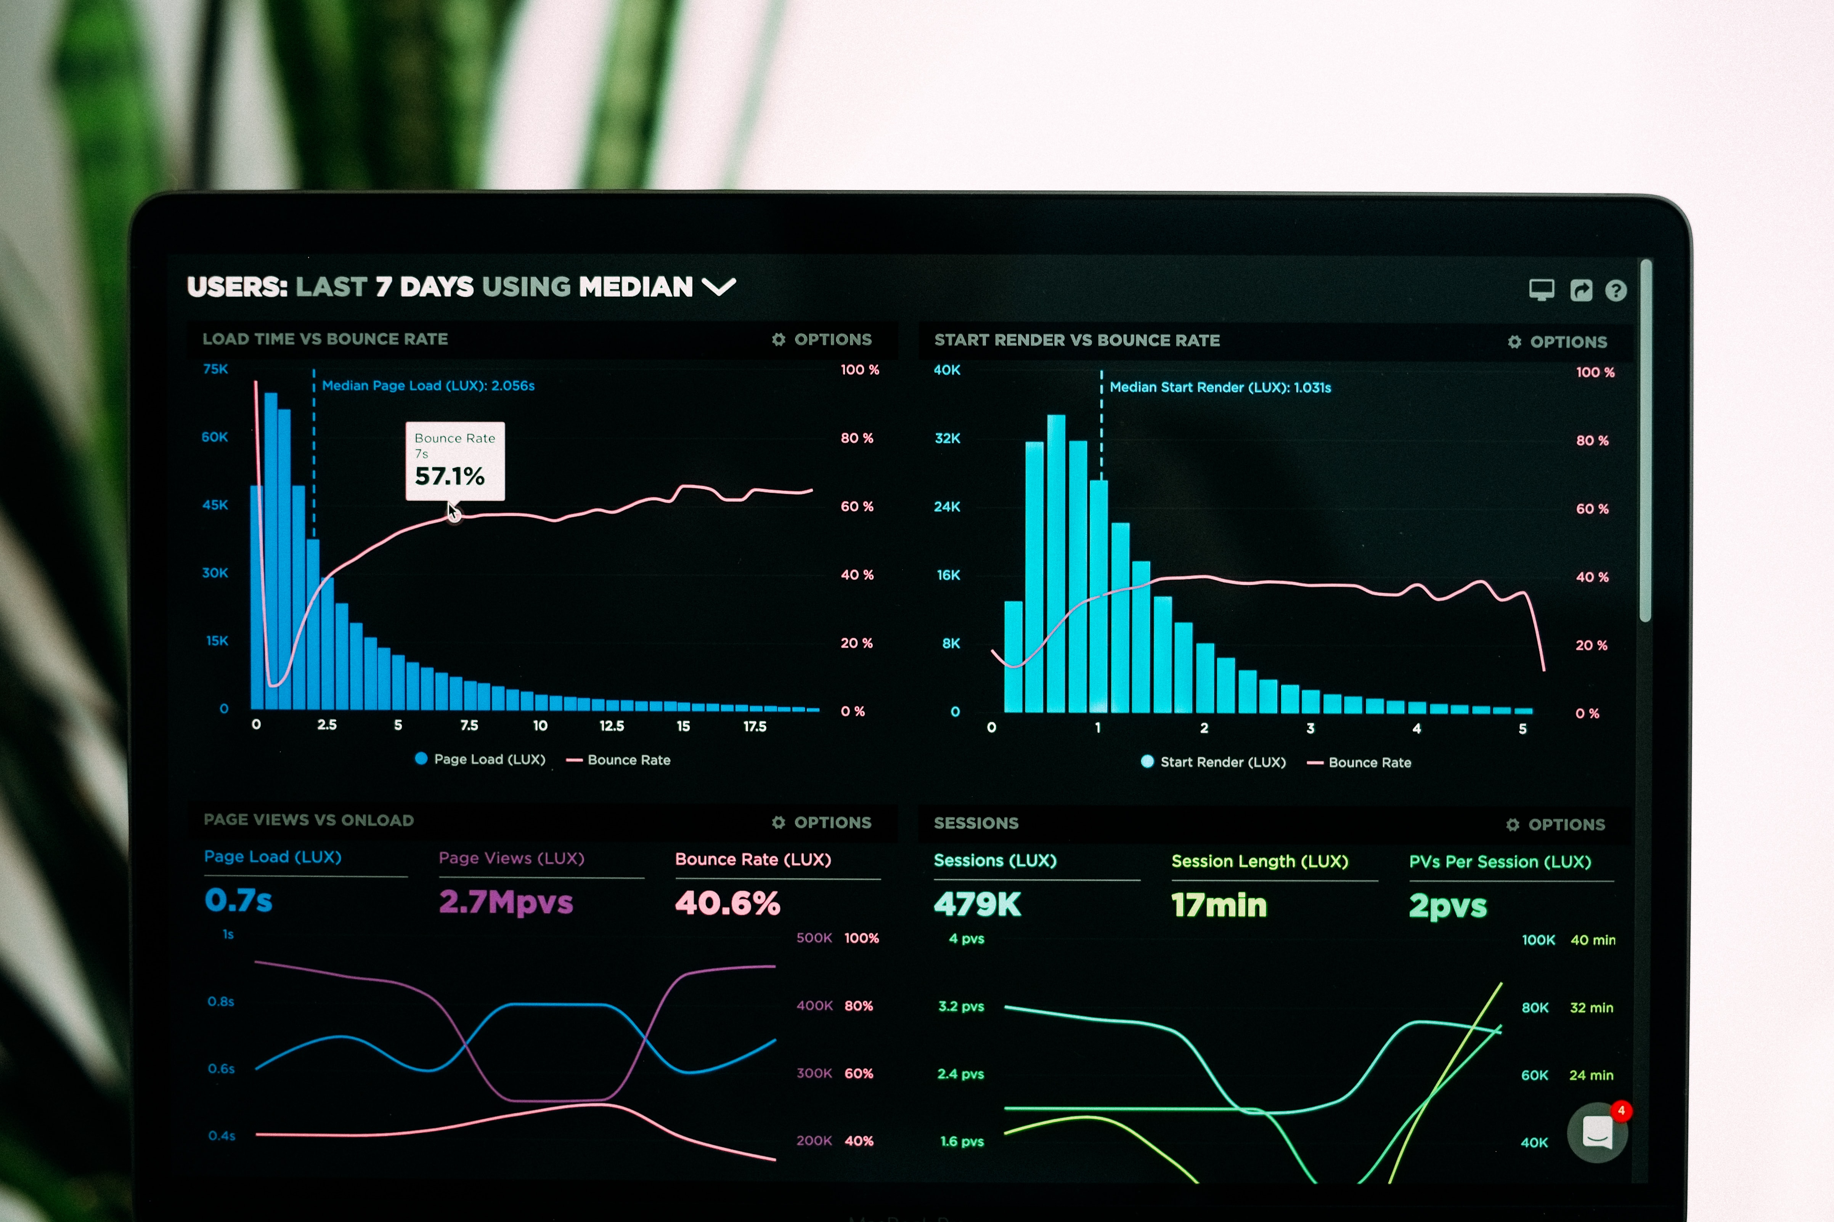
Task
Create an app that:
Gives us insights about student mental health
Visualizes data
Allows users to give input and adjust display in real-time

Slide 4
Data set
N = 101
International Islamic University of Malaysia
Columns include:
Gender | Age | Major | Year | CGPA Range | Married | Depression | Anxiety | Panic Attack | Treatment
Factor | Int | Factor | Int | Factor | Factor | Factor | Factor | Factor | Factor

Slide 5
Data Display
Predictor variables
Outcome variables
Gender | Age | Major | Year | CGPA Range | Married
Factor | Int | Factor | Int | Factor | Factor
Depression | Anxiety | Panic Attack | Treatment
Factor | Factor | Factor | Factor

Slide 6

App Design
Allow users to filter by student demographics
Default setting: Include all students in sample
Show how many students are left after filtering
Show all output/dependent variables simultaneously

Slide 7
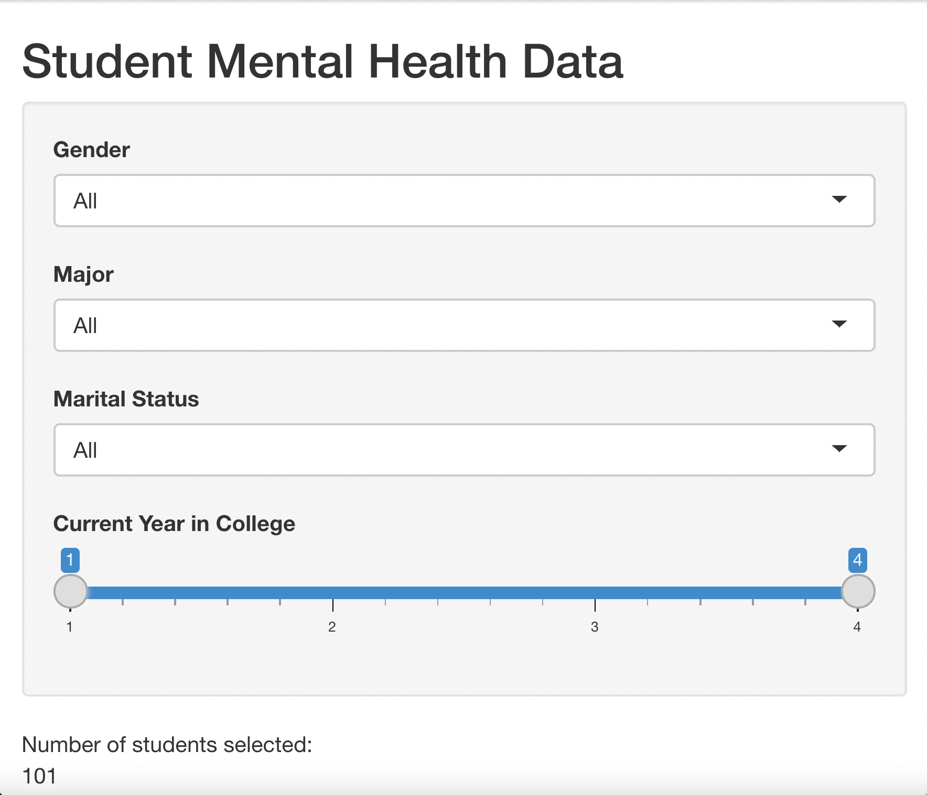
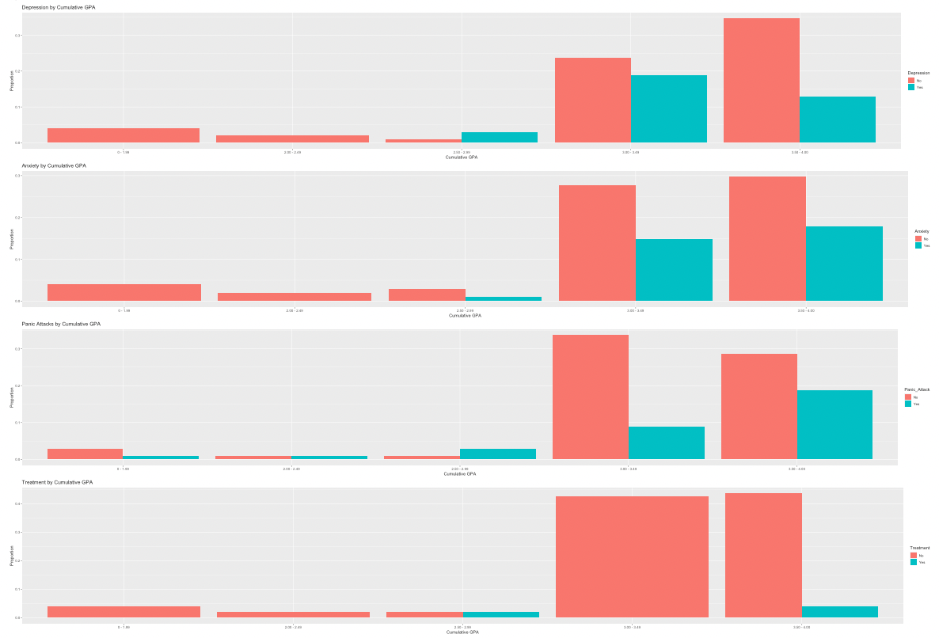
App Interface
Depression
Anxiety
Panic Anxiety
In Treatment

Slide 8
Insights
Only 8 students in year 4
Not enough students in each major to make comparisons
Gender skew – 75 women, 26 men
CGPA skew – 85+% of students have 3.00 cumulative GPA or higher
This is where we see the most mental health symptoms
Marital status skew – 16 students married, 85 unmarried
In short: all input variables are skewed – difficult to make any conclusions, especially given small sample size

Slide 9
Practical Value
This is a proof of concept for mental health dashboards
Provides easy snapshots of student mental health
Can be used to identify demographics most at risk
Can be shared with the student body as well as counselors and administrators

Slide 10
Future Directions
Upload larger dataset
Less skew for gender and year
More students in each major
Would be helpful to have longitudinal data to track progress of treatment

Slide 11
Photo Credits
Total Shape
Luke Chesser
Brett Jordan

